Slide 1


GRADUATION
PROJECT
Supervisors:
Dr.Ashraf Armoush & DR.Anas Toma
Students:
Omar Ratrout , Maen khader

Slide 2


Nablus Bus
Our project aims to provide a complete solution with a three-tier ticketing system tailored to different passenger needs, real-time bus location tracking for better trip planning, and an easy-to-use admin dashboard for managing users and buses, and generating reports on tickets, trips, and revenues.
Introduction and Objective

Slide 3




Problem
Nablus Bus company operates an internal tracking system for administrators to monitor bus routes, but passengers have no direct access to real-time bus location data. Instead, the only way passengers and drivers interact is through WhatsApp groups.

Slide 4








Technologies
React js -> website React Native -> mobile
Node js
Reastful api
version control &
collaboration platform
front end
Back end
Data base

Slide 5

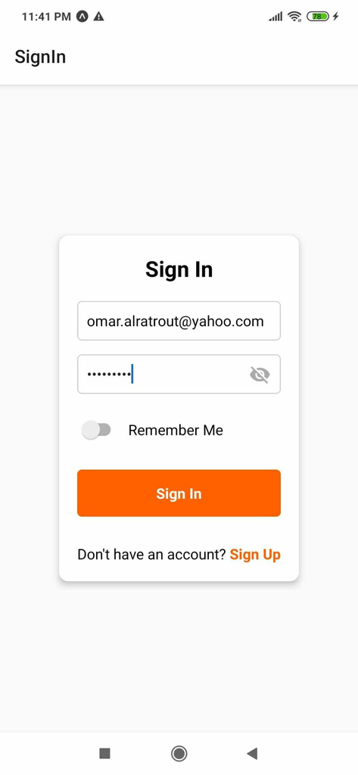
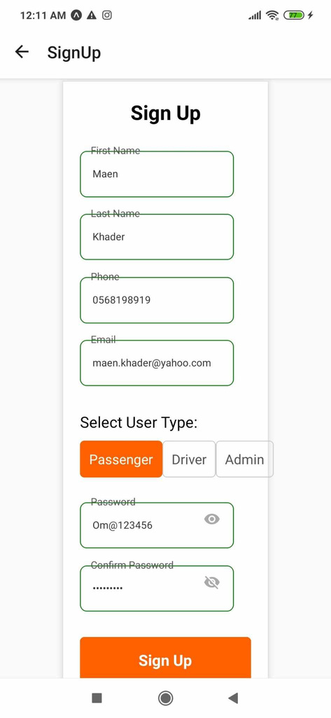
Registration Page
sign in
sign up
We have 3 user role
Admin - monitors system and manages buses
Driver - initiates and completes trips
Passenger - books tickets and uses bus services

Slide 6
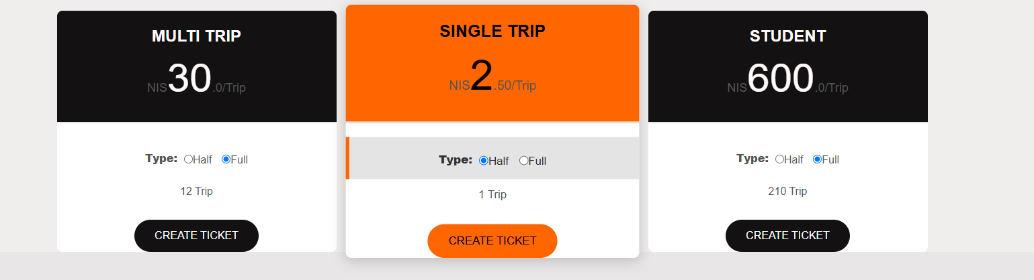
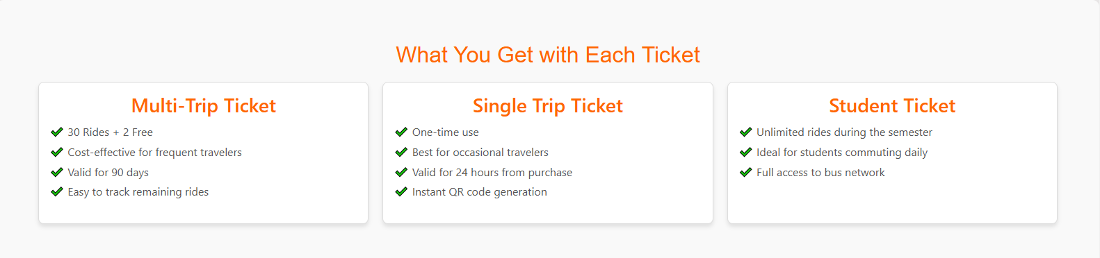
Passenger pages
Ticket Pricing
Ticket
binifits

Slide 7
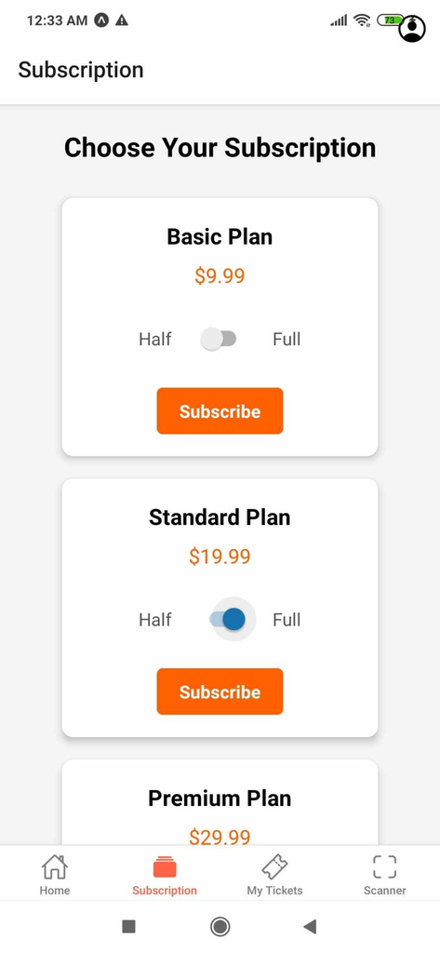
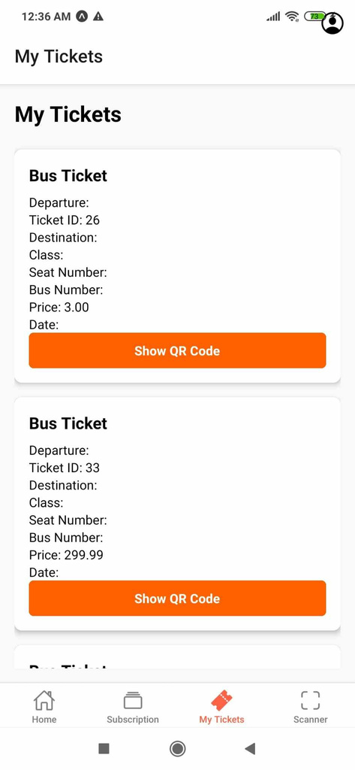
Passenger pages
Subscription
Residence
popup

Slide 8
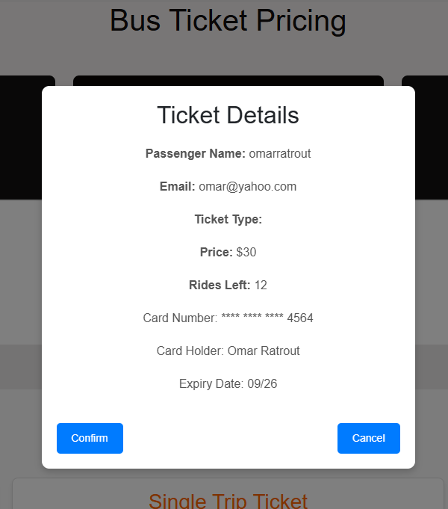
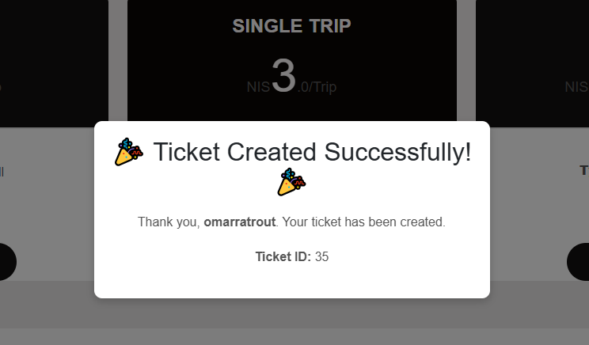
Passenger pages
Ticket details
Ticket conformation

Slide 9
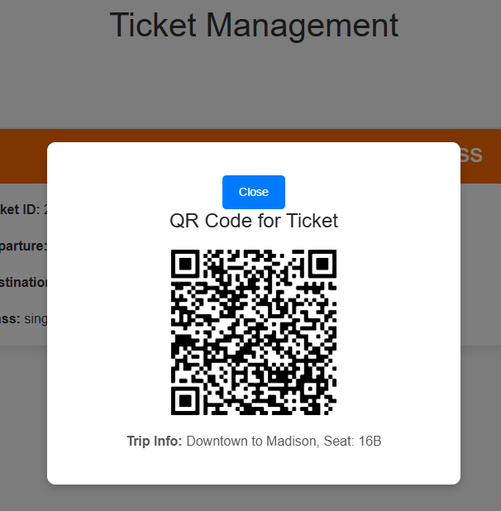
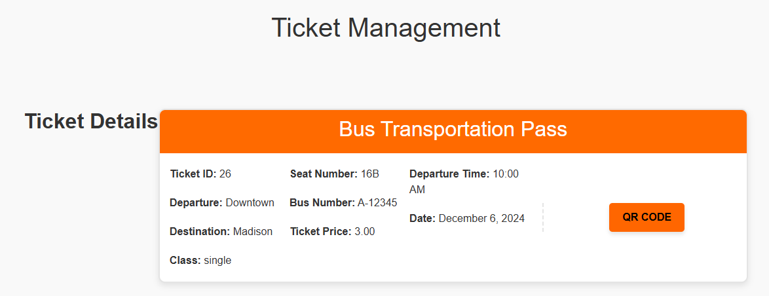
Passenger pages
My Tickets
Qr-code

Slide 10
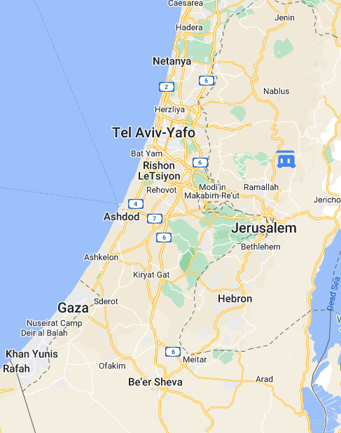
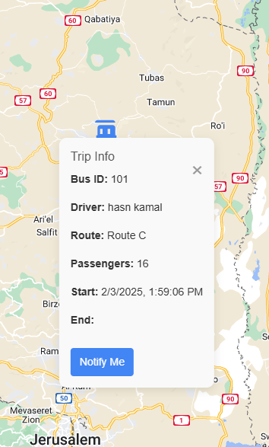
Passnger Pages
Buses Tracking
Bus info

Slide 11
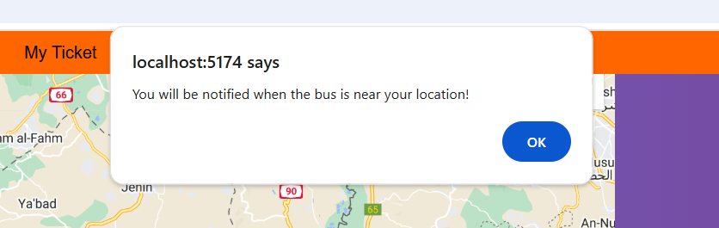
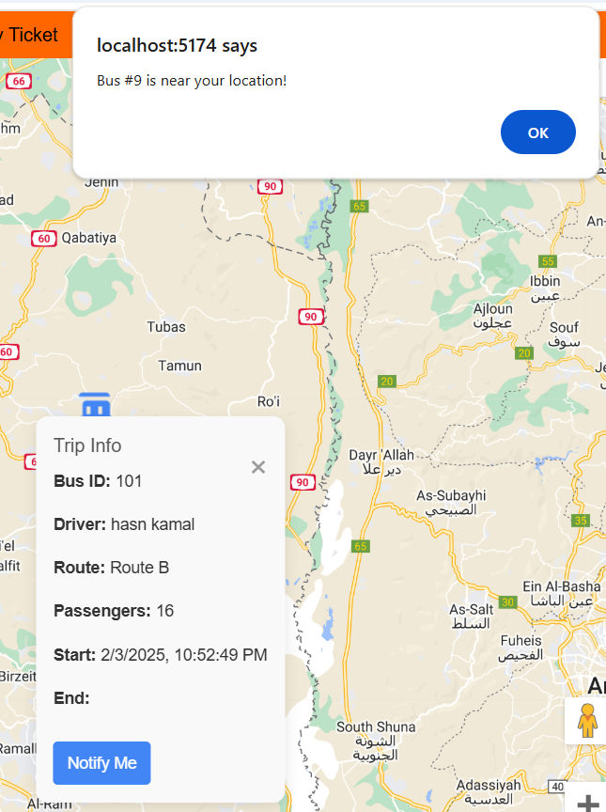

Passnger Pages
ask for notifications
send notification
notifications received

Slide 12
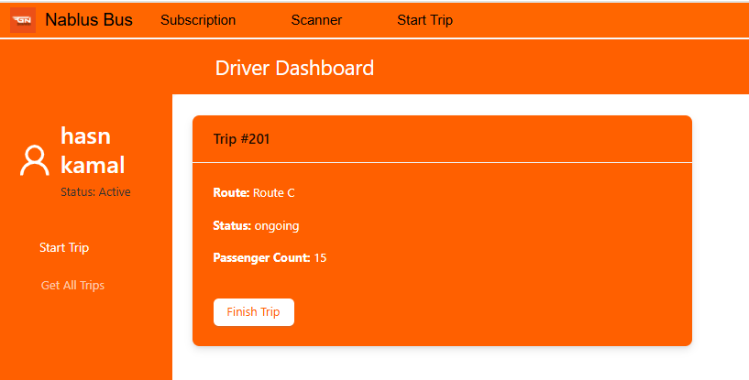
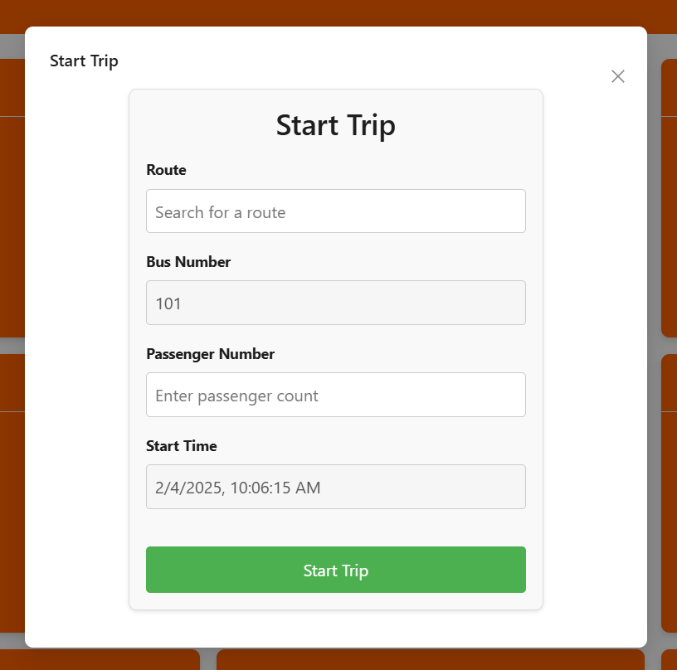

Driver pages
start trip
start trip
card
filter ticket by status

Slide 13
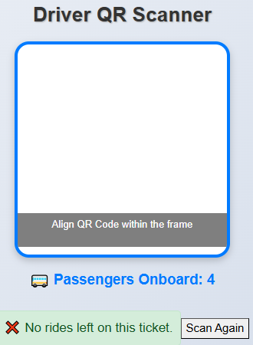
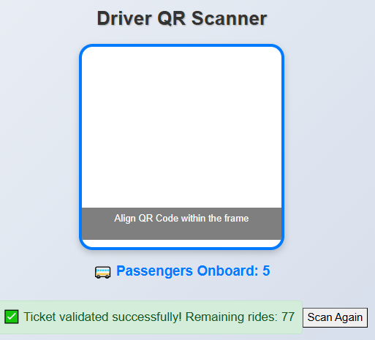
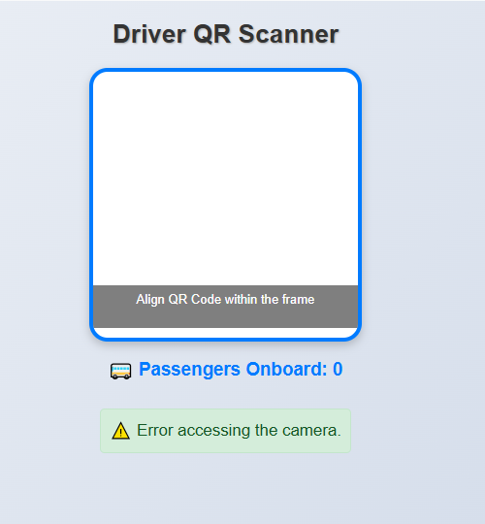
driver scanner page
camera permission
denied
successful scan
ticket not valid

Slide 14
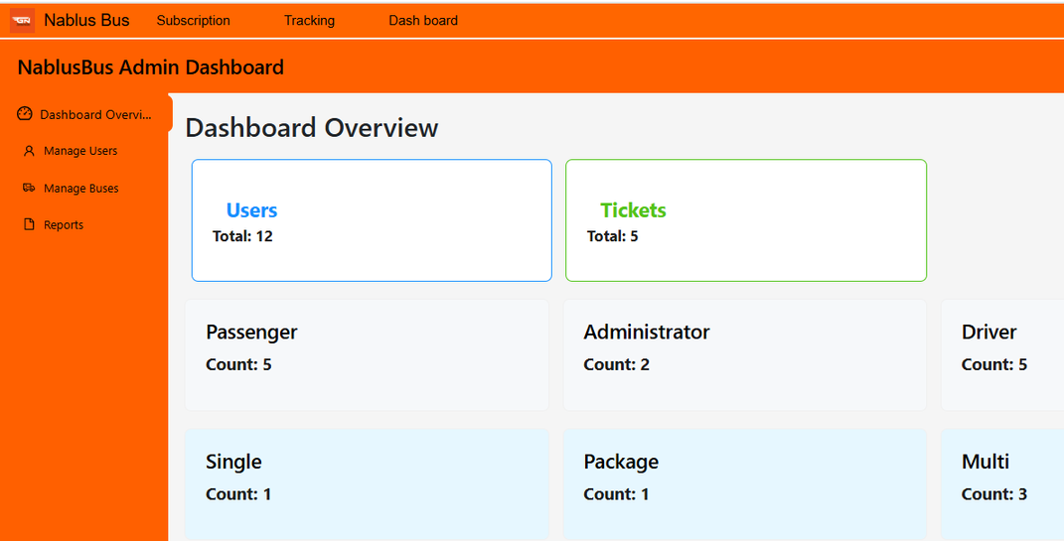
Admin dashboard
Overview
The admin dashboard is designed to monitor users, manage buses by adding new ones or updating their information, and generate reports on tickets, routes, and revenues.

Slide 15
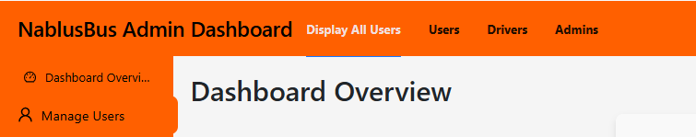
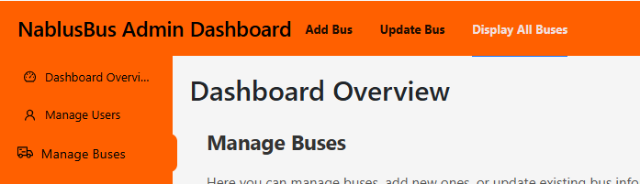
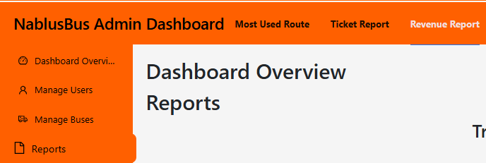
Admin dashboard
Manage users tabs
Manage Buses tabs
Generate Reports tabs

Slide 16
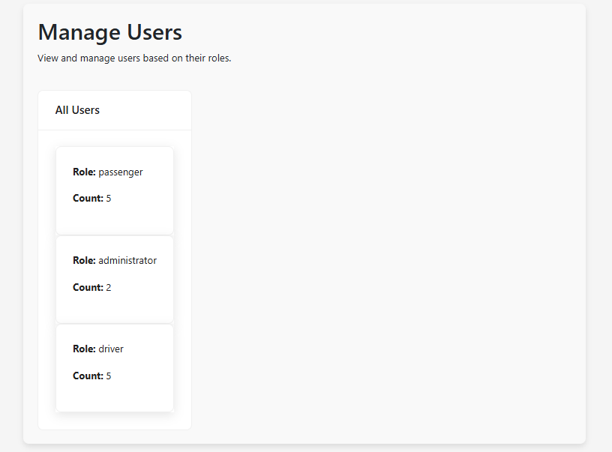
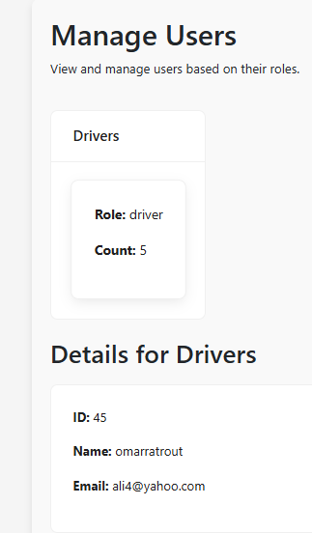
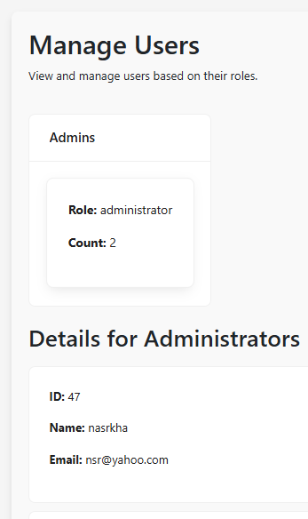
manage users
Display all users
Display driver
Display admin

Slide 17
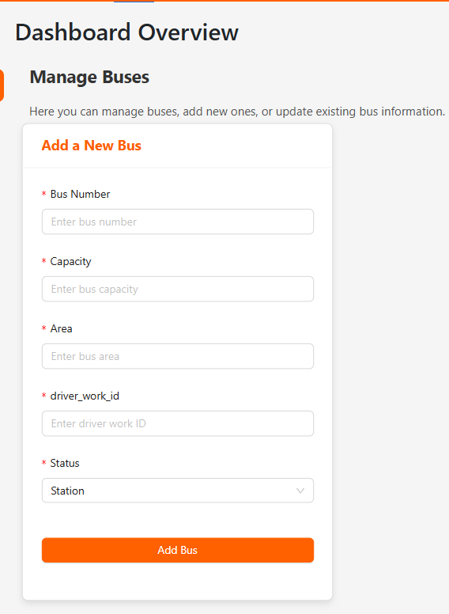
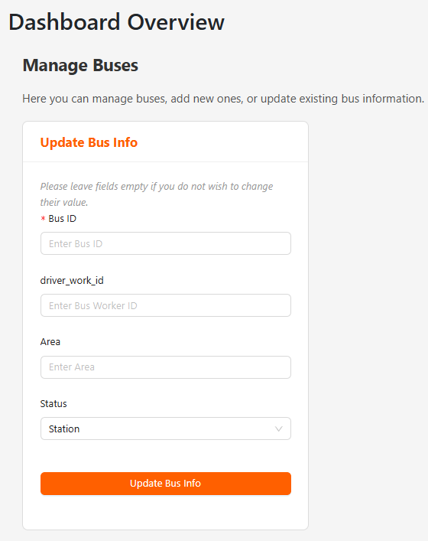
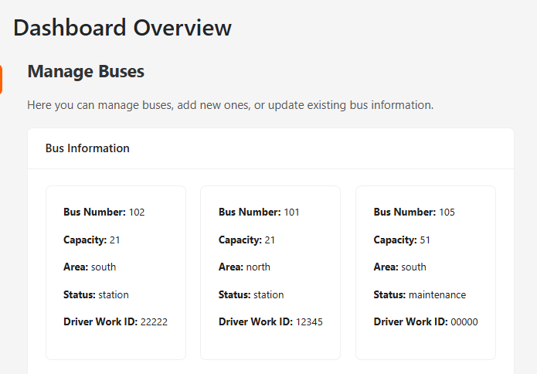
manage Buses
Add bus
update bus
display all buses

Slide 18
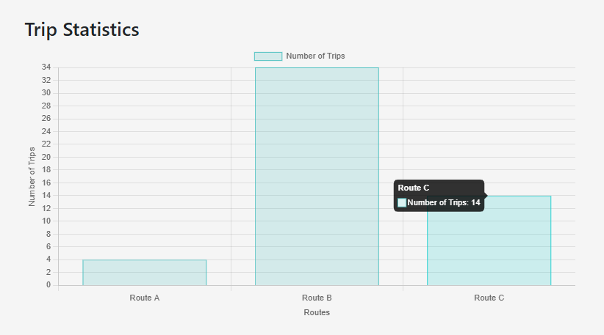
Reports
Trip statistic
The bar chart illustrates the number of trips recorded for three routes: Route A, B, and C.

Slide 19
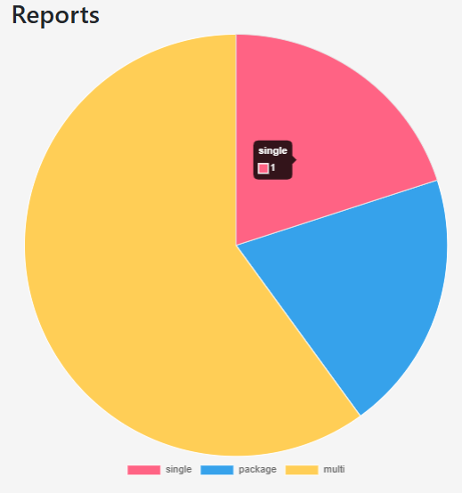
Reports
Ticket statistic
The pie chart represents the distribution of ticket sales across different ticket types: single, package, and multi.

Slide 20
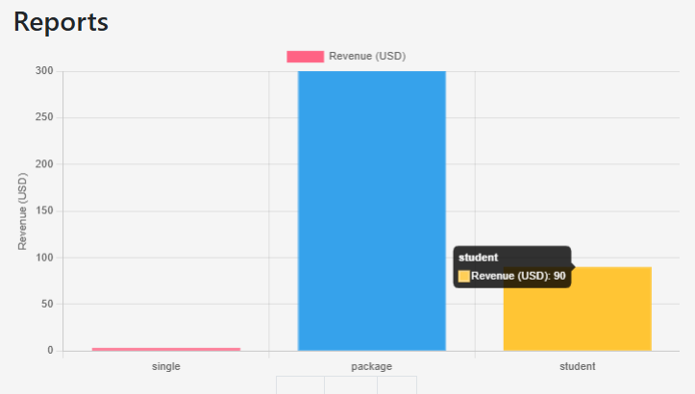
Reports
Revenue
The bar chart illustrates revenue distribution across different ticket types: single, package, and student.

Slide 21

FUTURE
WORK
1- Driver-to-Admin Emergency Notifications
2- Passenger Driver Rating System
3- allows users to request a refund for their subscription.

Slide 22
THANK YOU

